Slide 1
Graph of the Week
How to read, understand, and analyze real world data

Slide 2
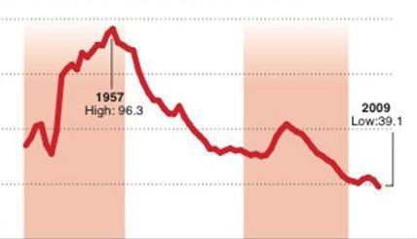
Describe in your own words what you think is happening in the graph below.
What information do you think we need to understand this graph better?

Slide 3
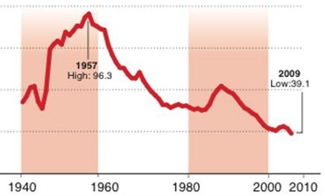
Does this help?

Slide 4
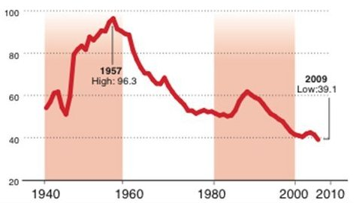

Slide 5
Will this help…?

Slide 6
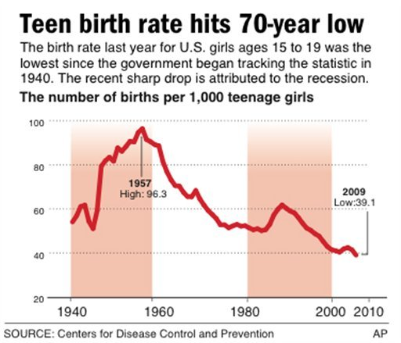
Do we have enough information now to figure out what this graph is about?
We need a TITLE or HEADING for the graph →
What the numbers along the y-axis mean →
← A time frame or timeline along the x-axis

Slide 7
What do you think the teen birth rate might be in 2013? What do you predict?

Slide 8
Let’s Write!
Write a few complete sentences that describe what the graph is telling you.

Slide 9
HW assignment (10 pts)
Due THIS FRIDAY:
Think of something that interests you (i.e. music, movies, Angels baseball, skateboarding, texting, law enforcement, cats, etc.)
In a newspaper, magazine, or website, find a graph that shows a statistical graph on your interest. (it can be a line graph, pie chart, bar graph, etc)
Be sure to choose a graph that is detailed and easy to understand.
Attach your graph to a blank sheet of paper with your name on it.

